Slide 1

DIGITAL PORTFOLIO
NAME :
REG NO :
NMID :
DEPT :
CLG :
YASIRA. J
41424134141802522037
E0112AF1A5C142799494DEF07046A6B3
B.SC COMPUTER SCIENCE
ST. THERESA'S ARTS AND SCIENCE

Slide 2

PROJECT TITLE
MODERN STUDENT PORTFOLIO

Slide 3

AGENDA
  Problem Statement
  Project Overview
  End Users
  Tools and Technologies
  Portfolio design and Layout
  Features and Functionality
  Results and Screenshots
  Conclusion
  Github Link

Slide 4

PROBLEM
STATEMENT
Create a visually appealing and user-friendly profile page that effectively showcases an individual's skills, experience, and achievements, while also providing a seamless navigation experience for visitors.

Slide 5





PROJECT
OVERVIEW
Objective
Create a profile page that showcases an individual's skills, experience, and achievements, providing a platform for networking, self-promotion, and career advancement.
Key Features
  User Profile Creation
  Profile Showcase
  Networking
  Search and Discovery

Slide 6
Professionals : Professionals can use their profile page to establish a personal brand, highlighting their expertise, skills, and experience.
END USERS
  Students
  Professionals
  Job seekers
  Software and so on.
Students : Students can showcase their projects, assignments, and achievements on their profile page.
Job seekers : Job seekers can use their profile page as a digital resume, making it easy to apply for jobs and showcase their skills.
Exploring creativity

Slide 7


TOOLS & TECHNIQUES
HTML
JAVASCRIPT
HTML is used to create the structure and content of web pages
JavaScript is a programming language that adds dynamic effects and interactions to web pages.
CSS
BOOTSTRAP 5
CSS is used to control the layout, appearance, and behavior of web pages.
Bootstrap 5 is widely used in web development for building responsive mobile-first web applications.

Slide 8
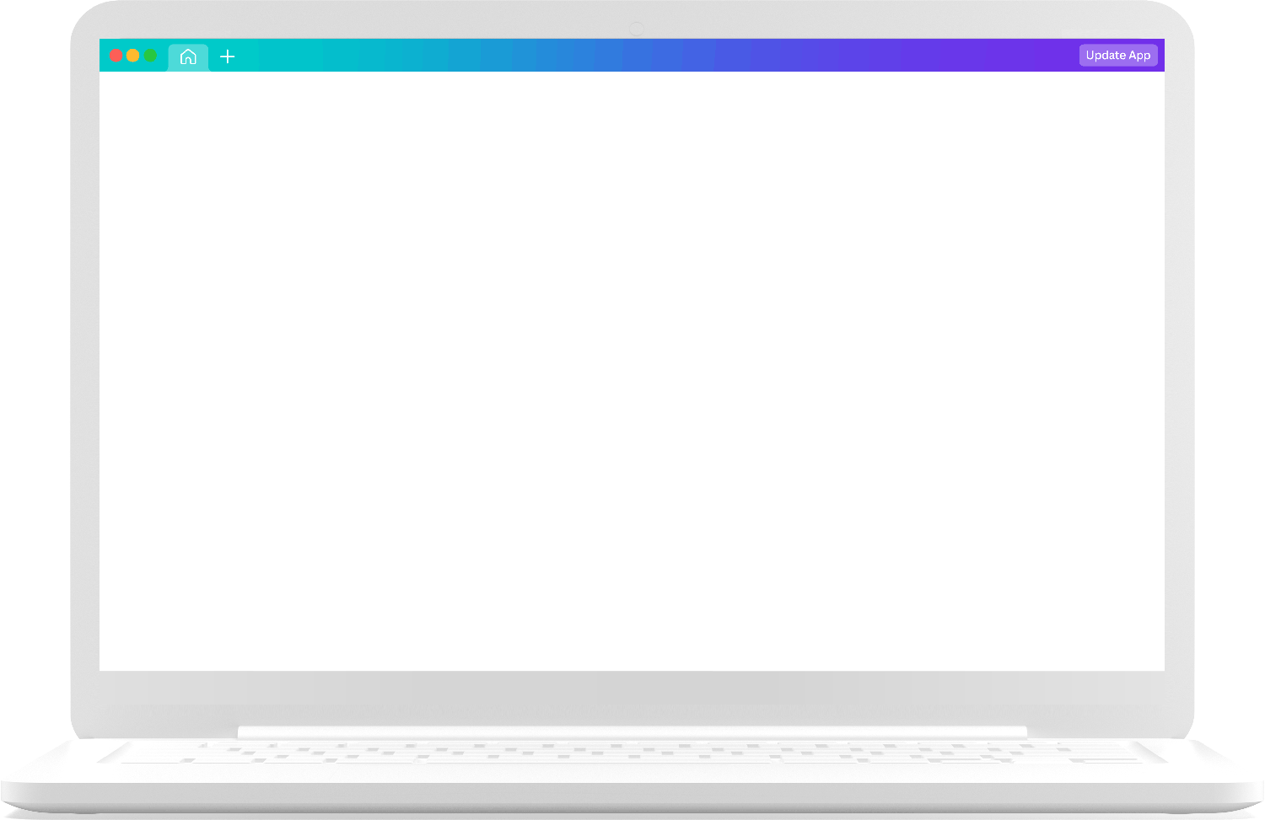

PORTFOLIO DESIGN & LAYOUT
  Home page with profile picture
  About me section
  Experience section
  Navigation bar with smooth scrolling
  Skills bar
  4 Slides
  Contact information

Slide 9
FEATURES & FUNCTIONALITY
Features
  Profile Picture
  Bio/About Section
  Skills and Expertise
  Education
  Projects and Portfolio
  Contact information
Functionality
  Profile creation
  Profile showcase
  Search and discovery
  Networking

Slide 10
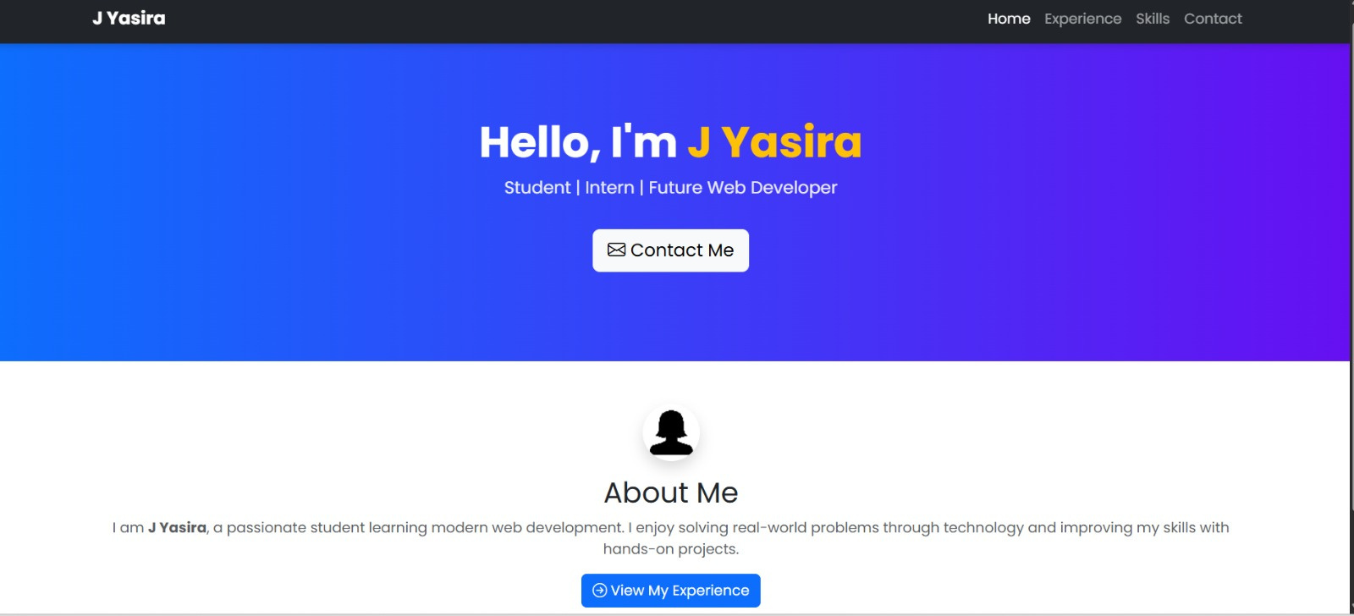
  RESULTS & SCREENSHOTS

Slide 11
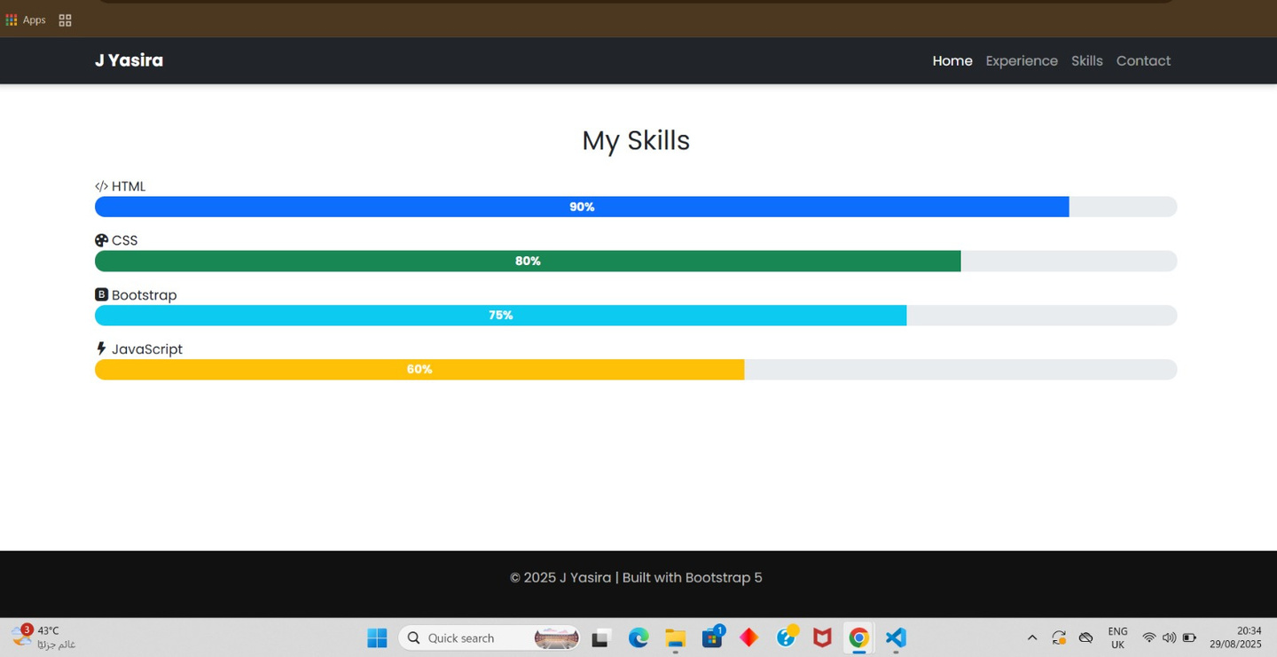
  RESULTS & SCREENSHOTS

Slide 12
CONCLUSION
Through this portfolio, I showcase my growth, skills, and accomplishments as a student, demonstrating my dedication to academic excellence and future success . I demonstrate my ability to design, develop, and deploy software solutions using various programming languages, including html, css, javascript and bootstrap.

Slide 13
GITHUB LINK
https://github.com/yasirasathik-js/Yasira.J-TNSDC-FWD-DP.git

Slide 14
Thank you very much!
PRESENTED BY YASIRA. J

